Slide 1

Enhanced Oil Recovery
University of Basrah
College of Engineering
Department of Petroleum
By:
Yaseen Riyadh Bandar

Slide 2
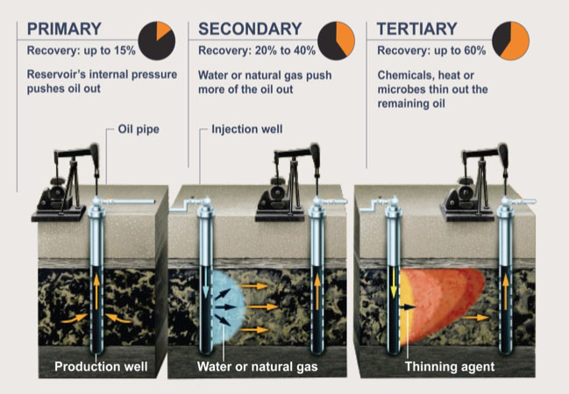

Slide 3
Outlines
Abstract
Why is EOR becoming an essential technique
Factor Affecting EOR
EOR Implementation Steps
The main types of EOR
Cost Comparison for EOR Methods
Conclusions
Recommendations

Slide 4
Abstract
Enhanced Oil Recovery
Rather than simply trying to force the oil out of the ground, as did in the primary and secondary recovery.
Enhanced oil recovery seeks to alter the properties of oil to make it more conducive to extraction.

Slide 5
Why is EOR becoming an essential technique
EOR helps to maximize the oil reserves recovered.
Extend the life of fields.
Increase the recovery factor.
It is an important tool for firms helping to maintain production and increasing the returns on older investments.

Slide 6
Factor Affecting EOR
Reservoir Depth.
Reservoir Heterogeneity.
Remaining Reserves (RR).
Rock Properties.
Fluid Properties.
Reservoir Drive mechanisms.

Slide 7
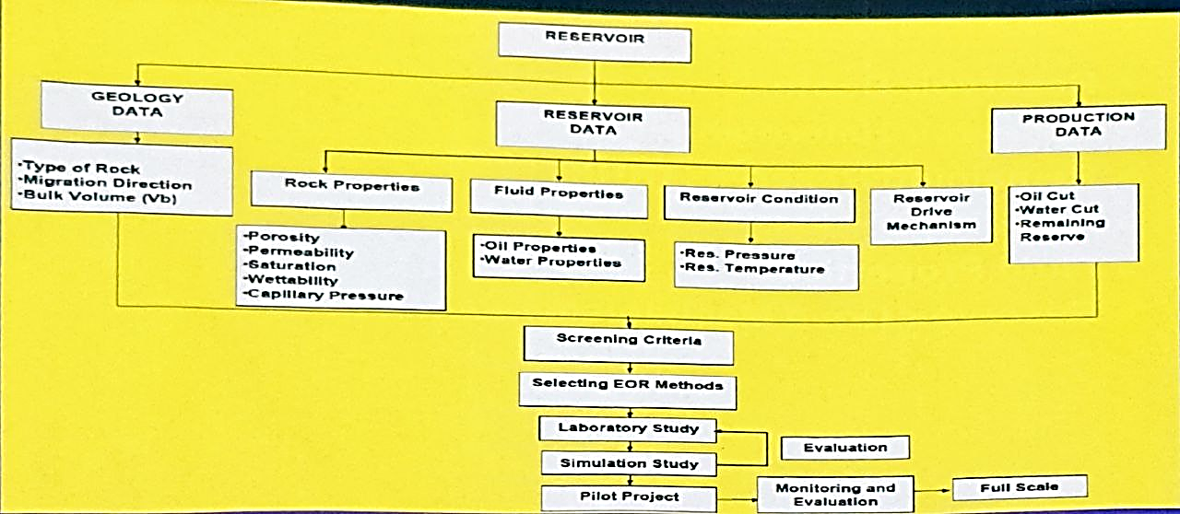
EOR Implementation Steps

Slide 8
The Main Types of EOR
Thermal Methods
Cyclic Steam Stimulation
Steam flooding
Gas Injection
First contact Miscibility
Chemical methods
Polymer Flooding
Multiple contact Miscibility
Surfactant Flooding

Slide 9
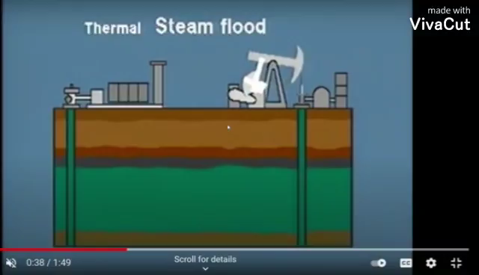
The Main Types of EOR
Thermal Recovery: such as CSC, CSS, SAGD methods

Slide 10
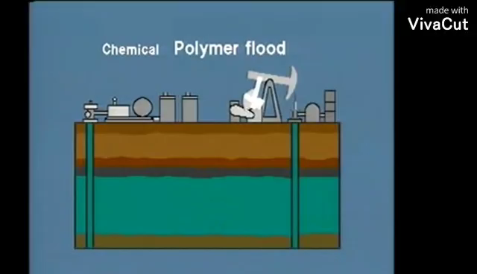
The Main Types of EOR
Chemical Flooding: such as Polymer and Surfactant flood.

Slide 11

The Main Types of EOR
Gas Injection: such as Inert gas, CO2, and Hydrocarbon fluid Injection

Slide 12
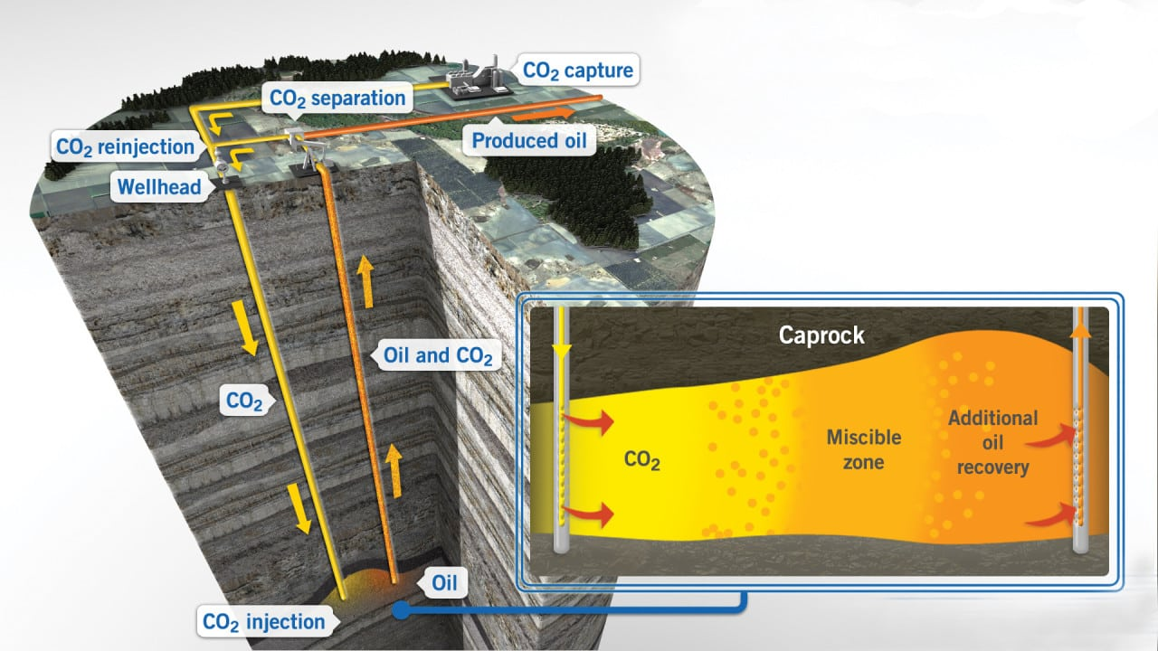
CO2 Injection

Slide 13
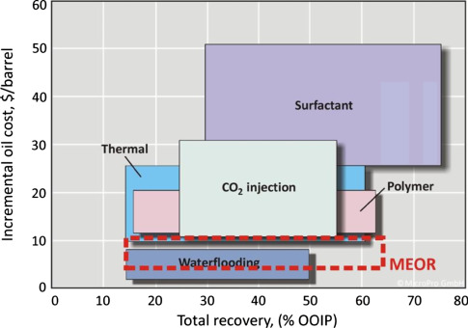
Cost Comparison for Different EOR methods

Slide 14
Conclusions
The world continues to rely heavily on oil for primary energy.
As the extraction of oil becomes more challenging, new techniques of EOR will need to be put in place to increase the amount of oil extracted from reservoirs.
Polymers play major role in the Enhanced Oil Recovery; they help extract up to 30% of the original oil in place.
Microbial Enhancement of Oil Recovery (MEOR), is less well established than the chemical and physical methods, but may have special advantages such as low operating costs and, perhaps, improved efficiency, which would make them especially attractive in the long run.

Slide 15


